Slide 1
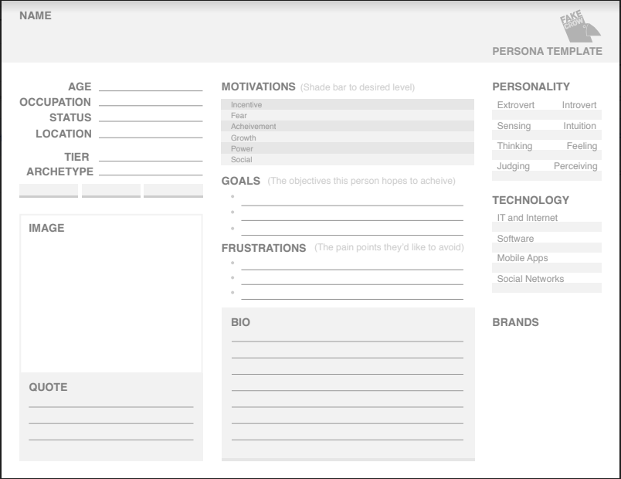
31
Music Teacher
Single
Manila
Veteran
Dynamic
To teach music the way she wanted to be taught
Wants to teach using the suzuki method
Wants to focus on the application of music and not just by music theory
Has to understand the family background of the student
Has to gain trust of the student
Wanted to be a performer

Slide 2
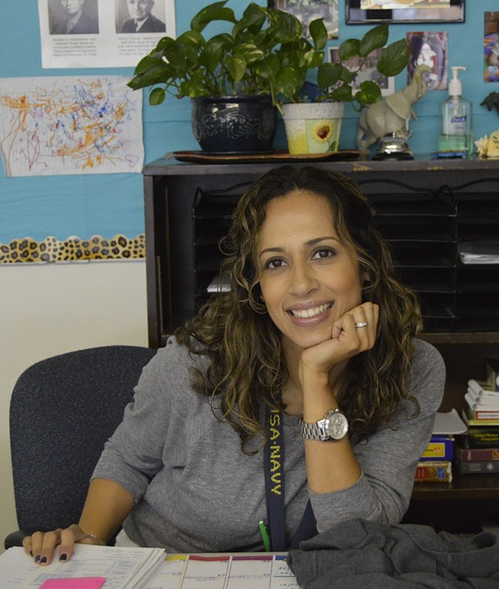
User Personas
Veteran Veronica
Goals:
To teach music the way she wanted to be taught
Wants to teach using the suzuki method
Wants to focus on the application of music and not just by music theory
Frustrations:
Has to understand the family background of the student
Has to gain trust of the student
BIO
Frankie is dynamic
Been teaching music for 14 years
31 Years Old
Wanted to be a performer, but instead pursued teaching
Plays the violin
Notes:
There are 8 initial personas. I’ll just breeze through them. * Just list the names of the personas *

Slide 3
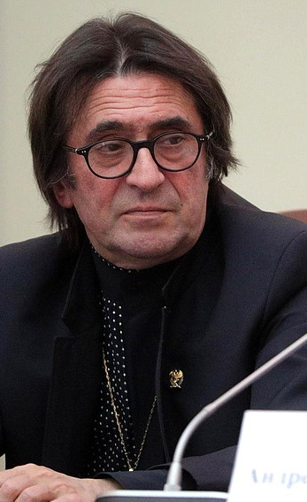
User Personas
Pitch Master Patrick
Goals:
To teach music using any method as long as it is enjoyed by the student
Teachers should adapt to student needs
To inspire kids by showing his passion for music
Frustrations:
Students require different methods
Keeping the kids entertained
Children need to be confident
BIO
Is a priest that teaches voice lessons to a choir
56 years old
Started getting into music since 4
20+ years of teaching experience
Notes:
There are 8 initial personas. I’ll just breeze through them. * Just list the names of the personas *

